Slide 1

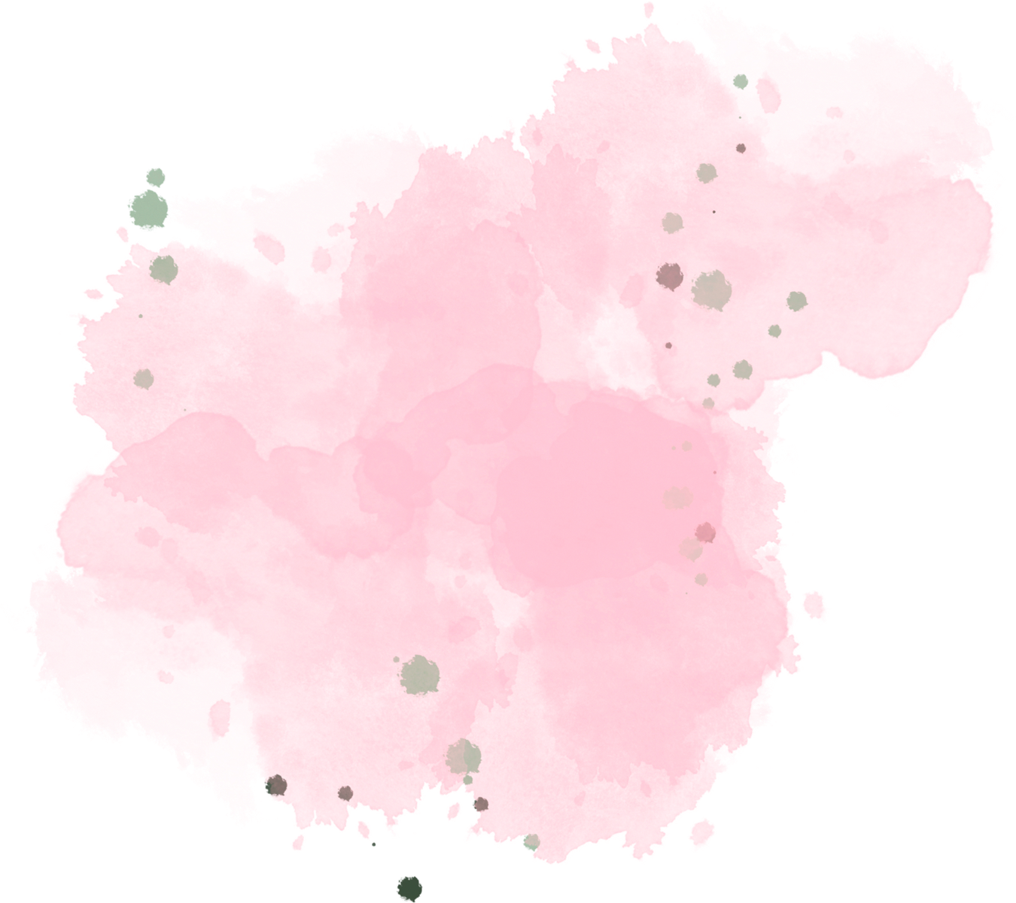
Protfolio

Slide 2


Digital protfolio
NAME :V.MEHA
REG NO. :30324U09049
NM ID. : C783F116A184C878BFA49A31165CD936
DEPARTMENT: BACHELOR OF COMPUTER APPLICATION
COLLEGE. : ARCOT SRI MAHALAKSHMI WOMEN'S COLLEGE
UNIVERSITY. : THIRUVALLUVAR UNIVERSITY

Slide 3
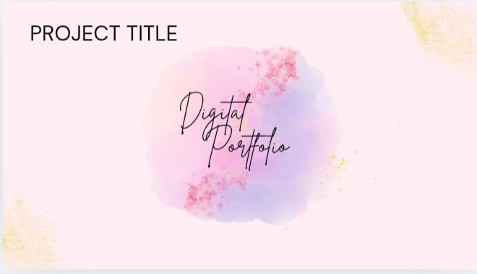

Slide 4
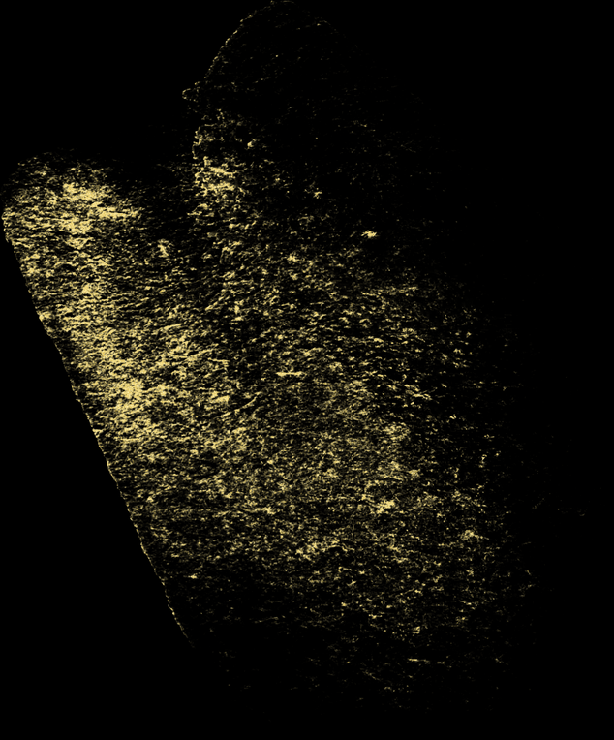


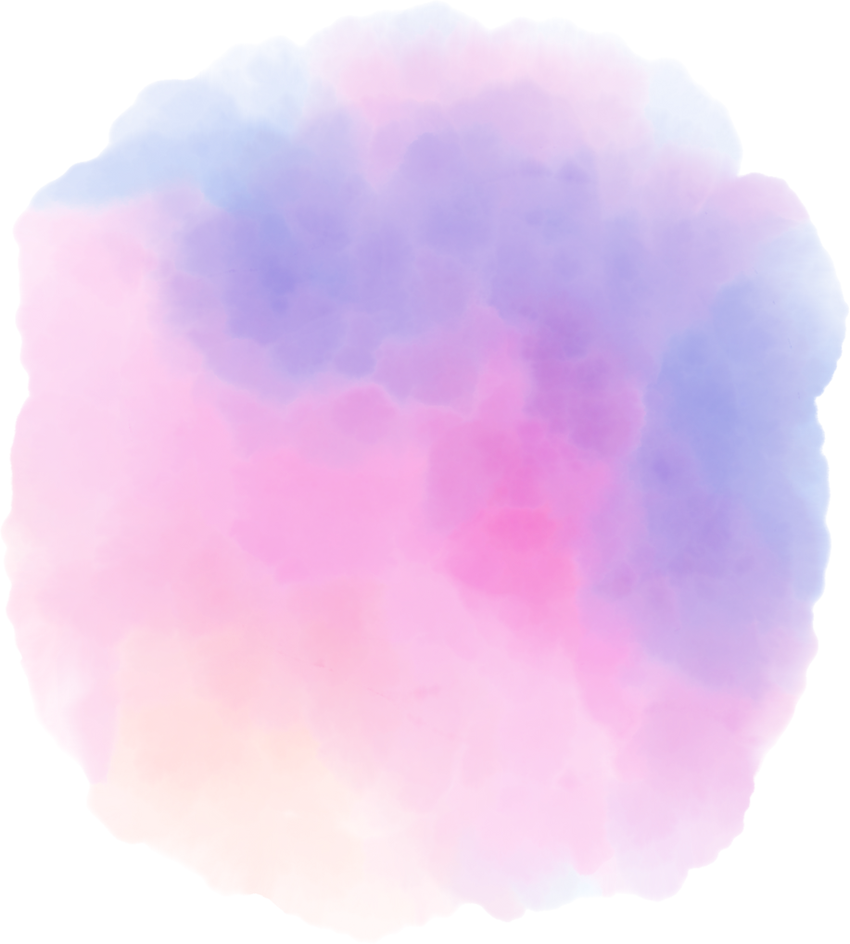
Introduction

Slide 5



Introduction
Hi, I’m Meha Vinayagam, a passionate and dedicated BCA 2nd-year student at Arcot Sri Mahalakshmi Women’s College, Villapakam. I have a strong interest in programming, web design, and creative problem-solving. My skills include Python, C, C++, HTML, CSS, and JavaScript, and I enjoy using them to build projects that are both functional and visually appealing.

Slide 6
Agenda

Slide 7
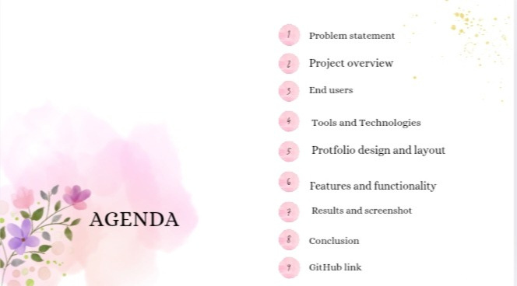

Slide 8


Problem statement
The problem is the lack of an interactive, easily accessible, and visually appealing medium that highlights both technical skills and personal interests. Without such a platform, opportunities to make a strong first impression on recruiters, mentors, or collaborators are limited.This digital portfolio aims to bridge that gap by presenting my work, skills, and achievements in a professional yet creative way, making it easier for others to know my capabilities at a glance.

Slide 9
Project preview
This Digital Portfolio is a personalized website designed to showcase my academic background, technical skills, projects, and hobbies in an interactive and visually appealing way. It highlights my knowledge of Python, C, C++, HTML, CSS, and JavaScript, while also reflecting my creativity through design and animations.
The portfolio serves as a professional online presence, making it easier for recruiters, teachers, and peers to explore my abilities, achievements, and interests in one place.

Slide 10
Who are the end user
The end users of this Digital Portfolio are:
1.Recruiters & Employers – to evaluate my skills, projects, and technical abilities for internships or job opportunities.
2. Teachers & Mentors – to assess my learning progress, creativity, and academic growth.
3. Peers & Collaborators – to connect, share ideas, and collaborate on projects.
4.General Audience – anyone interested in knowing more about my background, hobbies, and achievements.

Slide 11
Tools and techniques
HTML,CSS,JavaScript– Portfolio design & development
VS Code – Code editing
GitHub – Hosting & version control
Responsive Design – Mobile & desktop friendly
UI/UX Principles – Clean and user-friendly interface
CSS Animations – Interactive effects

Slide 12
Protfolio design and layout
🎨 Portfolio Design & Layout
🏠 Home Page – Neon circle with profile & options
🙋 About Section – Introduction & academic details
💻 Skills Section – Programming & technical skills
📂 Projects Section – Showcase of works & achievements
🎨 Hobbies Section – Personal interests & activities
📩 Contact Section – Email/contact form

Slide 13
Features and functionality
🏠 Interactive Home Page with neon circle
📱 Responsive Layout – works on all devices
🧭 Navigation Menu – quick access to sections
💻 Skills & Projects Showcase
🎨 Hobbies Section – creative interests
📩 Contact Form – easy communication
✨ Animations & Styling for modern look

Slide 14

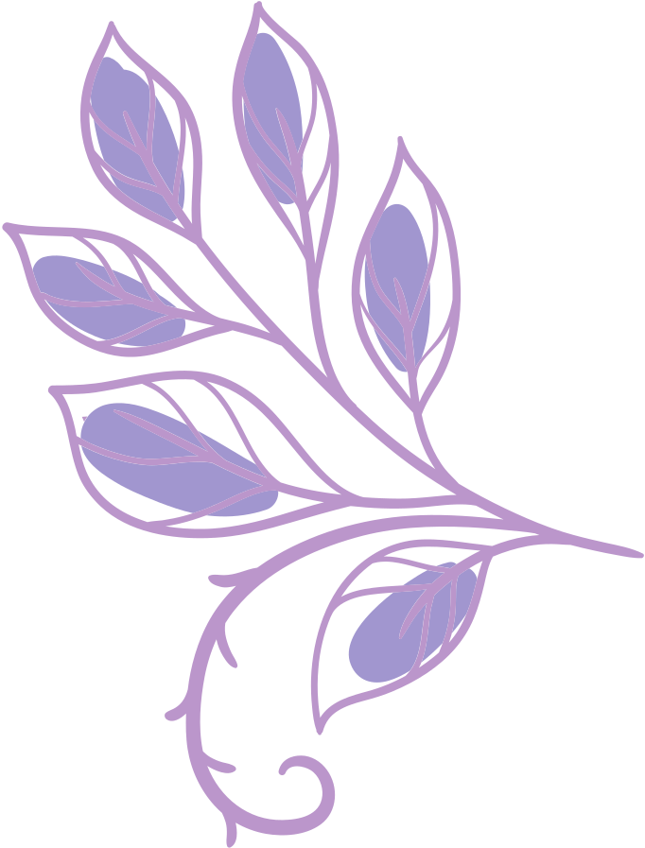

Results

Slide 15
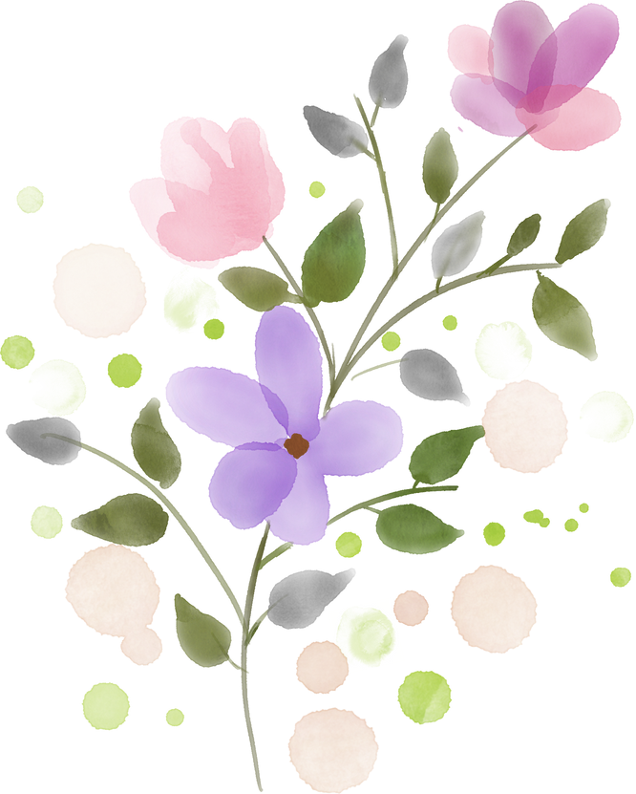
✅ Successfully designed a digital portfolio website
🎨 Modern neon circle home page with clean UI
💻 Showcased skills, projects, and hobbies effectively
📱 Fully responsive design – works on mobile & desktop
Results and screenshots

Slide 16
Screenshot s

Slide 17
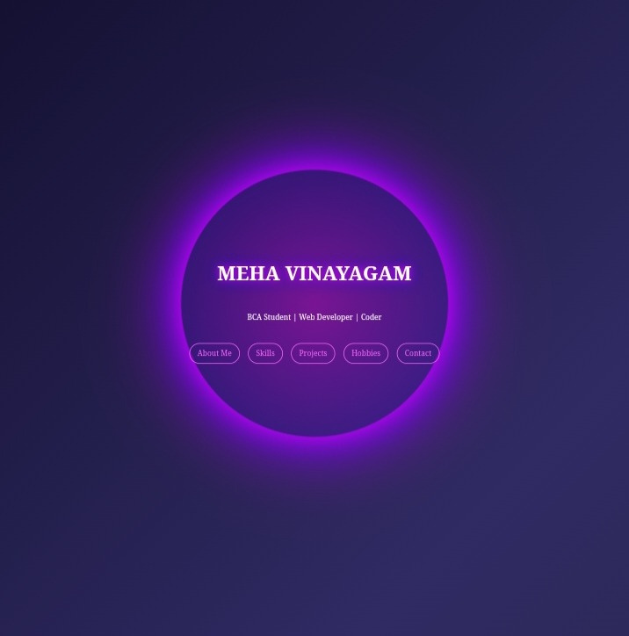

Slide 18
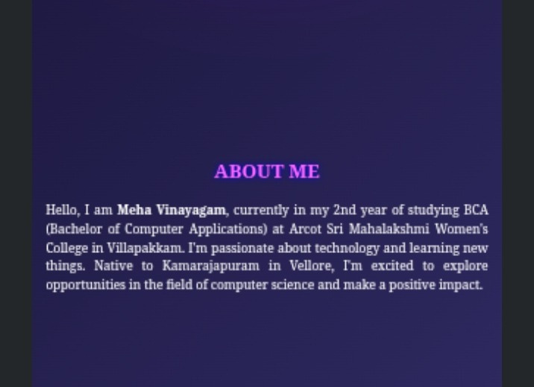

Slide 19
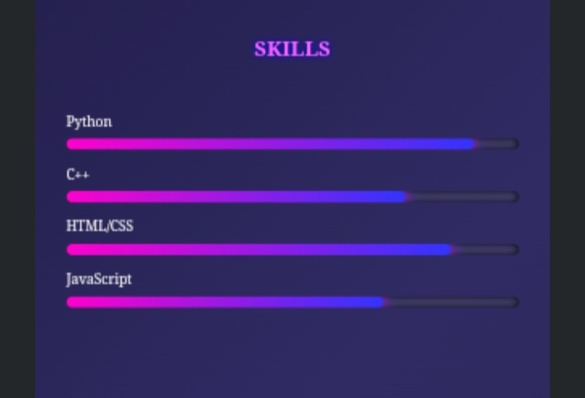

Slide 20
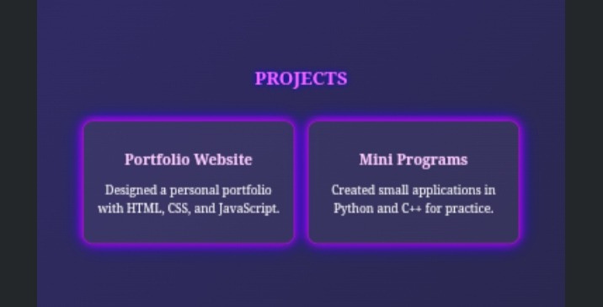

Slide 21
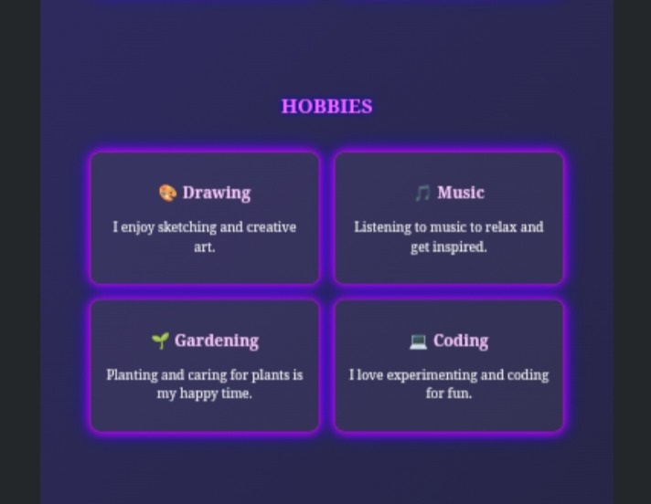

Slide 22
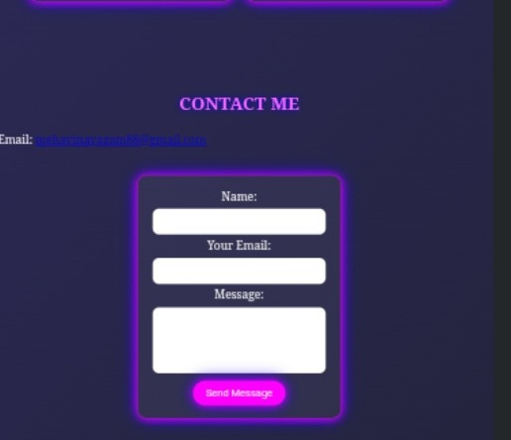

Slide 23
Conclusion
📌 Created a digital portfolio to showcase skills, projects & achievements
🎨 Designed with a modern neon theme and responsive layout
⚡ Provides an interactive, user-friendly platform
🚀 Enhances my professional presence for future opportunities

Slide 24
Thank You

